Slide 1
Image Steganography Without Embedding
A Novel Method for Secure Communication in Networks
23MIA1038 KAJJOL AIYER
23MIA1146 SHREEYA NITHI
23MIA1164 ARYA.K

Slide 2
The Problem with Steganography
Traditional Steganography
Traditional methods hide data *inside* a cover image (e.g., LSB substitution). This directly alters the image's statistical properties.
The Insecurity
Modern **Steganalysis** tools (like YeNet, XuNet) are deep learning models trained to detect these tiny statistical alterations.
The Result
The "secret" message is easily discovered, and the communication channel is compromised. Traditional embedding is no longer secure.

Slide 3





Motivation: The "SWE" Gap
A new method, Steganography Without Embedding (SWE), generates a new image *from* the secret data instead of altering an existing one. This is much more secure, but...
Low Capacity
Low Extraction Accuracy
The Objective
Most current SWE methods are unable to securely handle large amounts of secret data. The steganographic capacity is too small for practical use.
To develop a new SWE method that dramatically improves information capacity and extraction accuracy while maintaining high security.
Even when data is hidden, retrieving it is difficult. Data is often corrupted, with baseline methods achieving only 85-90% extraction accuracy.

Slide 4






Our Proposed Method: Key Innovations
Carrier Secret Tensor
Wasserstein Distance
Weight Clipping
Combines the secret message with a carrier wave. This restores noise diversity, preventing image unity and enabling precise, high-accuracy extraction.
Used as the discriminator's loss function. It perfectly measures the distance between image distributions to balance image quality and extraction accuracy.
Constrains the discriminator's weights, preventing it from overfitting to the cover image and ensuring the secret message's integrity remains the top priority.

Slide 5
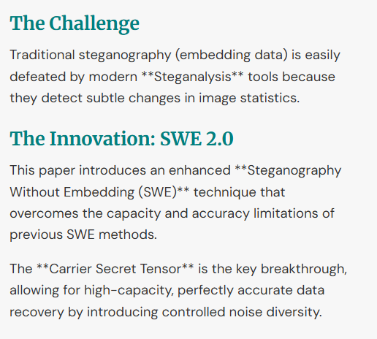
Paper Summary: Core Concept

Slide 6
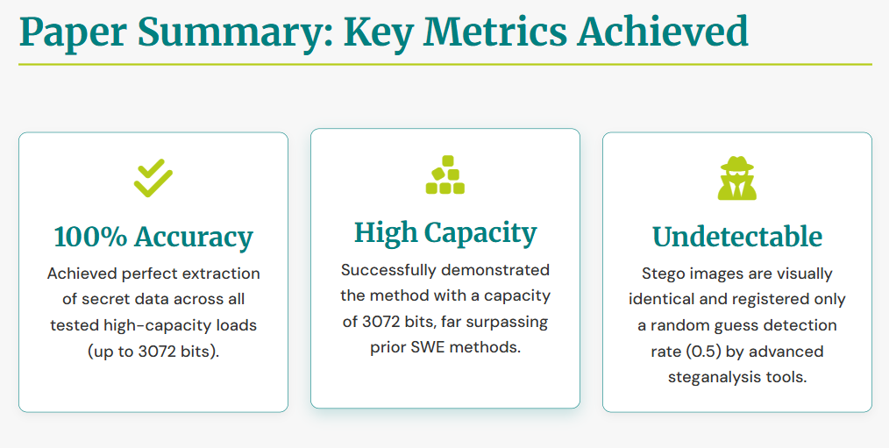

Slide 7
Methodology: Secret Information Generation
Input: A Secret Message (M) is combined with a Carrier Wave (f(tm)).
Decouple: The model gets Structural (S1) and Texture (T1) info from a separate cover image.
Mapping: The Message (M) is first mapped to a Secret Tensor (Z).
Generate: A generator (Gstu) creates new Structural info (S2) from our Carrier Secret Tensor (Z').
Combine: This Secret Tensor (Z) is added to the Carrier Wave to create the key Carrier Secret Tensor (Z').
Output: A final generator (G) combines (S1, S2, T1, T2) to create the final, secure Stego Image (Ist).

Slide 8
Methodology: Secret Information Extraction
Isolate: The known Carrier Wave (f(tm)) is subtracted from Z'', leaving the clean Secret Tensor (Z''').
Input: The received Stego Image (Ist).
Extract (Step 1): A Structural Extractor (E) retrieves the Structural Information (S') from the image.
Inverse Map: The Secret Tensor (Z''') is processed by an inverse mapping function (Eq. 9).
Extract (Step 2): A Tensor Extractor (Ex) gets the Carrier Secret Tensor (Z'') from S'.
Output: The original Secret Message (M') is perfectly and completely recovered.

Slide 9








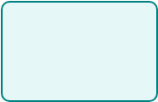



Methodology Flow Diagram
Secret Message (M)
Create Carrier Tensor (Z')
Generator (G_stu, G)
Stego Image (Ist)
Carrier Wave
Stego Image (Ist)
Extractor (E, Ex)
Get Carrier Tensor (Z'')
Secret Message (M')
Carrier Wave

Slide 10
Results: Extraction Accuracy
Accuracy at High Capacity
Accuracy at 3072 bits
2304 bits:
3072 bits:
Baseline (IDEAS): ~87.07% Accuracy
Baseline (IDEAS): ~87.50% Accuracy
Our Method: 100% Accuracy
Our Method: 100% Accuracy
The model consistently achieves perfect (100%) extraction accuracy, even at high capacities, demonstrating the robustness of the carrier secret tensor method.

Slide 11








Results: Image Quality & Security
Forensically Undetectable
State-of-the-art steganalysis tools (YeNet, XuNet) showed a detection rate of ~0.5.
This is equivalent to a random guess.
Cover Image (Input)
Stego Image (Output) (2304 bits)
The generated stego image is visually identical AND highly resilient to automated detection.

Slide 12


Key Findings & Future Enhancements
Key Findings
Future Enhancements
The **Carrier Secret Tensor** method is highly effective for SWE.
The primary limitation identified is the visual quality (FID score) of the generated images, which still has room for improvement.
The model achieves **100% extraction accuracy** at high capacities (2304 & 3072 bits).
Future work will focus on further **improving the image fidelity** (making the images look even more realistic).
The system is secure and **resistant to steganalysis tools**, with detection rates at chance (0.5).
The goal is to maintain 100% accuracy and security while achieving an even higher-quality visual output.
**Wasserstein distance** and **weight clipping** are crucial for balancing the conflicting goals of image quality and data accuracy.

